Slide 1
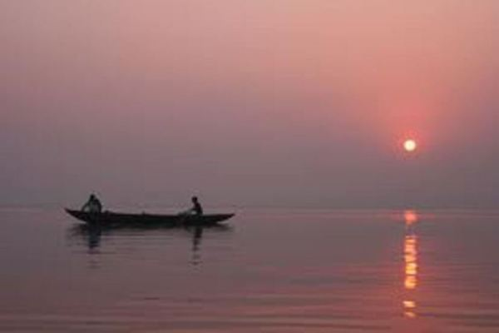
Rivers of India

Slide 2
Northern rivers
Indian rivers
Peninsular rivers

Slide 3
Northern rivers
Peninsular rivers
Indus
West flowing
Ganga
East flowing
Brahmaputra

Slide 4
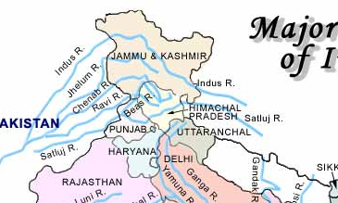
Indus river
Indus + 5 tributaries
After partition: Indus water Treaty 1960
Indus, Jhelum, Chenab to Pak
Ravi, Beas and Sutlej to India
Chej doab, ReChna doab, Bari doab, Bist doab

Slide 5
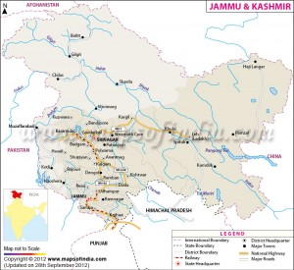
Tributaries of Indus
Cities on Indus –Leh
Tributaries:
Shyok from Siachin glacier
Suru (Obsequent tri) – originate from Deosai mt. , Burzil la pass, kargil on it, chutak dam
Gilgit – last tri in India
Hunza riv
Gilgit riv
Siachin glacier
Suru riv
Shyok riv
Indus riv
Zaskar riv

Slide 6
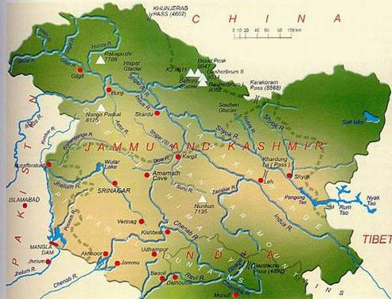
Tributaries of Indus: Jhelum
Jhelum river:
Rises at Verinag
Shrinagar
Kishanganga joins on right
Kishanganga river dispute with Pakistan
Jhelum enters Pakistan near Baramulla
Kishanganga river
Jhelum river

Slide 7
Tributaries of Indus: Chenab
Two headward tributaries: Chandra and Bhaga
Chnadra originate near Zozi la and Bhaga at Baracha la
Dhulhasti, Baglihar and Salal dams
Chandra river
Bhaga river

Slide 8
Tributaries of Indus: Ravi
Source near Rohtang pass in Himachal Pradesh
Drains between Pripanjal and Dhauladhar
Chamba is located on Ravi

Slide 9
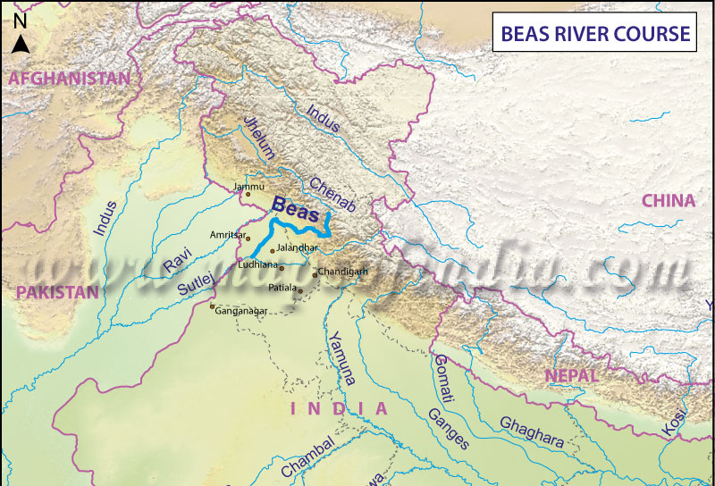
Tributaries of Indus: Beas
Source near Rohtang pass - at southern end of Pir Panjal (HP)
Meets Satluj at Harike
Kulllu on Beas’s tributary Parbati
It is entirely within India

Slide 10
Tributaries of Indus: Satluj
Originate near Man sarovar
Enters India through Shipki la pass
Imp tributary: Spiti
Neptha-jhakhari dam

Slide 11
UPSC
Question
Q. Which one of the following rivers does not originate in India?
Beas
Chenab
Ravi
Sutlej
Ans. D)
Prelims
2009

Slide 12
UPSC
Question
Q. From north to south, which one of the following is the correct sequence of given rivers in India?
Shyok- Spiti-Zaskar-Sutlej
Shyok-Zaskar-Spiti-Sutlej
Zaskar- Shyok-Sutlej-Spiti
Zaskar-Sultej-Shyok-Spiti
Ans. b)
Prelims
2006

Slide 13
Northern rivers
Peninsular rivers
Indus
West flowing
Ganga
East flowing
Brahmaputra

Slide 14
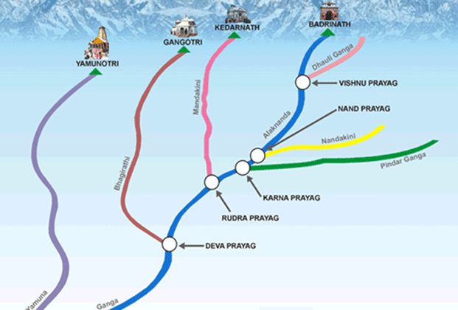
Ganga system
Originate as Bhagirathi from Gangotri
Alaknanda originates from Badrinath
Dhauliganga meet Alaknanda at Vishnu prayag
Pindar river (from Nanda devi) meet Alaknanda at Karn Prayag

Slide 15
Ganga system
Mandakini (from Kedarnath) meet at Rudra prayag
Alaknanda and Bhagirathi meet at Dev prayag
After merger known as Ganga

Slide 16
Ganga System
Left Bank tributaries
Right Bank tributaries
Ramganga
Gomati
Ghaghar
Gandak
Kosi
Yamuna
Son
Hugli

Slide 17
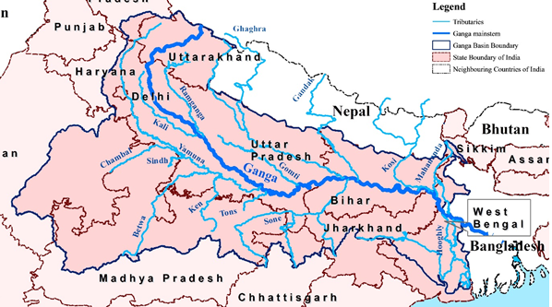
Ganga system: left bank tributaries
Ramganga
Gomati
Ghaghra (Saryu)
Gandak
Kosi

Slide 18
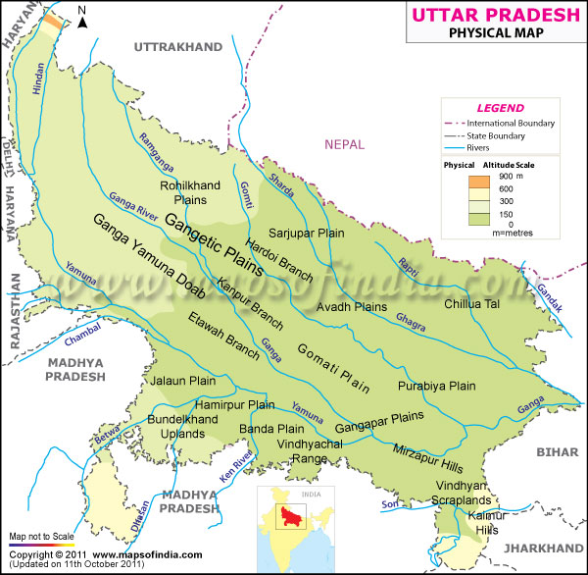
Ganga system: left bank tributaries
Ramganga
Originate near Garhwal
Gomati: north UP
Lucknow is on Gomati
Both originate within India
Ramganga
Gomati
Ganga

Slide 19
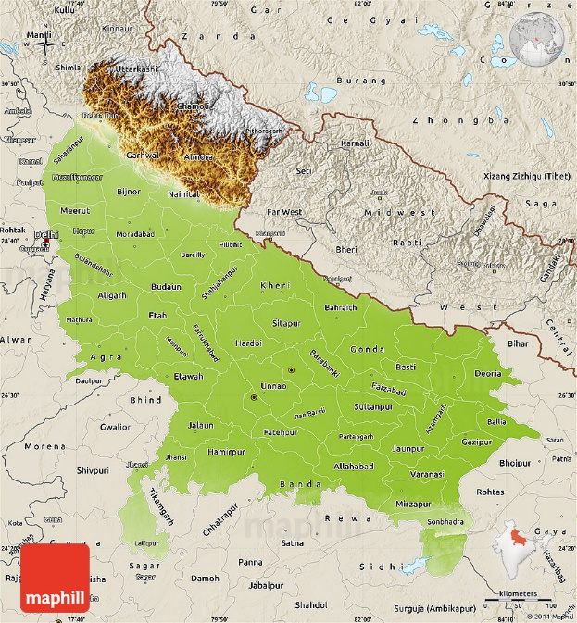
Ganga system: left bank tributaries
Gurla mandhata peak
Ghaghara – originate from Gurala mandhata peak (South of Man sarovar) in Tibet
Two headward streams: kali (Sarda) and Karnali
Ayodhya, Faizabad located on Ghaghara
Man sarovar lake
Karnali river
Kali (Sarda) river
Rapti river
Ghaghara river

Slide 20
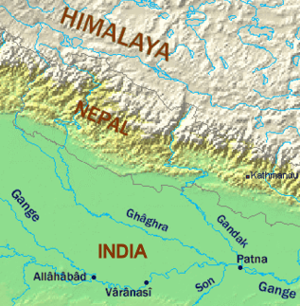
Ganga system: left bank tributaries
Gandak originated near Nepal-Tibet border
Kali Gandaki and Trishuli imp tributaries
Merge in Ganga near Patna
Kali Gandaki

Slide 21
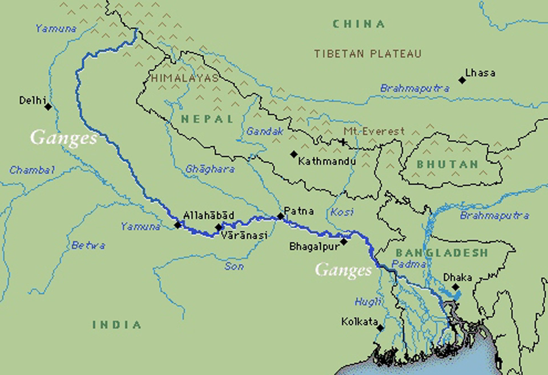
Ganga system: left bank tributaries
Kosi- ‘Saptkaushi’
7 streams
Located in snow covered areas – heavy rainfall – huge volume of water
7 streams -> 3 stream -> merged at Triveni (mahabharat range) to form Kosi
Kosi

Slide 22
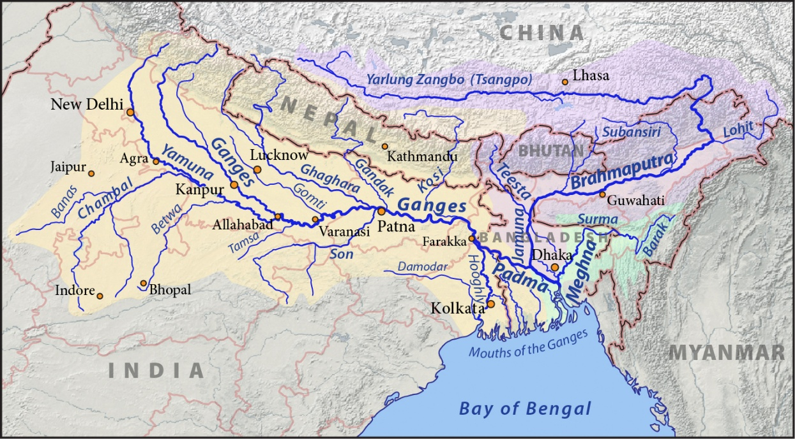
Ganga system: right bank tributaries
1) Yamuna
Originates from Yamnotri glacier – Bandarpunch peak –Garhwal
Imp tributaries:
Right bank -Tons-rises from Bandar punch glacier

Slide 23
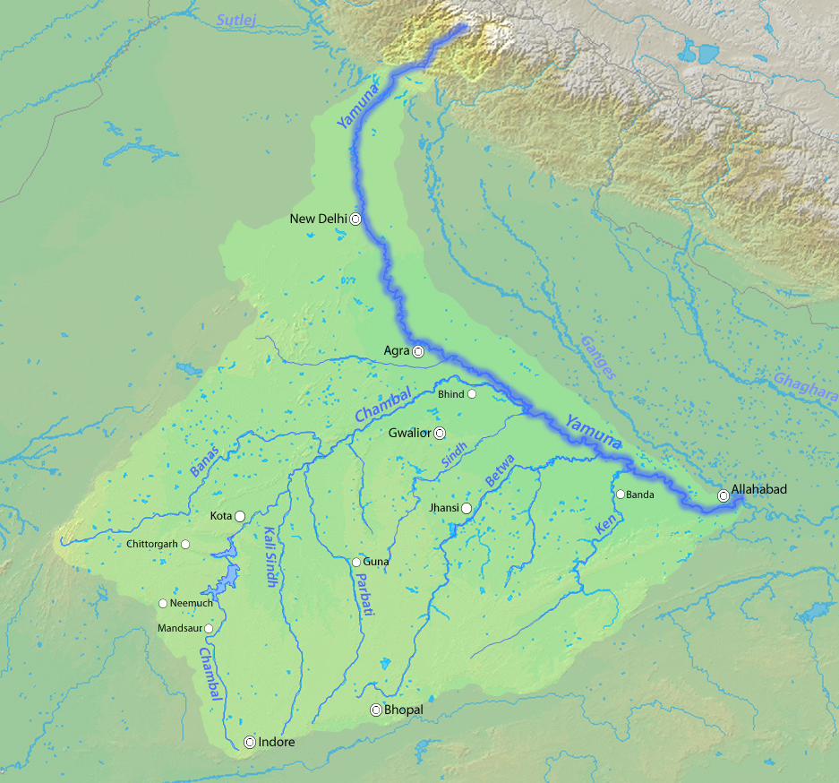
Ganga system: right bank tributaries
Delhi, Agra and Mathura on Yamuna
Its imp right bank tributaries from Vindhyan range
Chambal, Sindh, Betwa and Ken
Banas tri of Chmabal originate from Aravalli
Chambal
Sindh
Betwa
Banas
Dhasan
Ken
Parbati
Kali sindh

Slide 24
Ganga system: right bank tributaries
2) Son
From Amarkantak plateau
Imp tributaries: Rihand – source Ramgarh hills
Govind vallabh pant sagar on Rihand
North Koel – source –Chhota Nagpur plateau
Son river
Rihand
Kaimur hills
Baghel
Amarkantak plt
Ramgarh hills

Slide 25
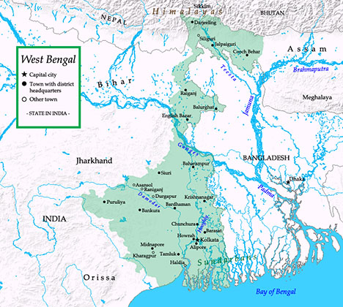
Ganga system: right bank tributaries
3) Hugli
Distributary of Ganga
Tributary: Ajay
Kolkata on river Hugli
Ajay river
Hugli river
Kolkata

Slide 26
UPSC
Question
Q. Rivers that pass through Himachal Pradesh are:
Beas and Chenab
Beas and Ravi
Chenab, Ravi and Satlej
Beas, Chenab, Ravi, Satlej and Yamuna
Prelims
2010

Slide 27
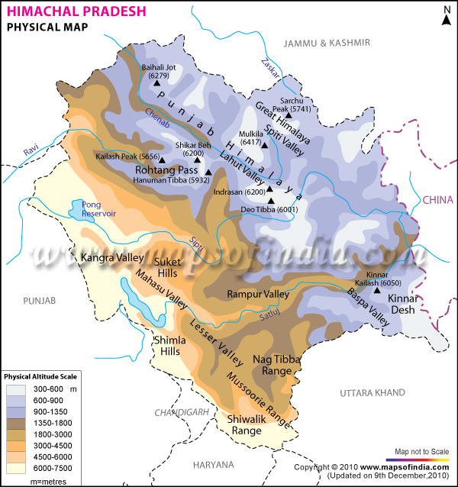
Rivers in Himachal Pradesh
Chenab
Ravi
Beas
Satlej – Spiti
Yamuna on border between HP and Uttarakhand
Chenab
Ravi
Beas
Spiti
Satlej
Yamuna

Slide 28
UPSC
Question
Q. Rivers that pass through Himachal Pradesh are:
Beas and Chenab
Beas and Ravi
Chenab, Ravi and Satlej
Beas, Chenab, Ravi, Satlej and Yamuna
Ans. D)
Prelims
2010

Slide 29
Northern rivers
Indus
Ganga
Brahmaputra

Slide 30
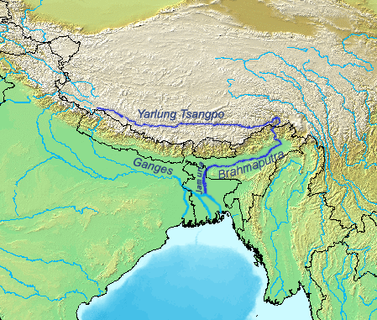
Brahmaputra system
Originate from Chemayungdung glacier in Kailash
Passes in Indus-Tsangpo sature zone (between Great Himalayas and Kailash range)
Enters into India as Dibang
Kailash range
Dihang

Slide 31
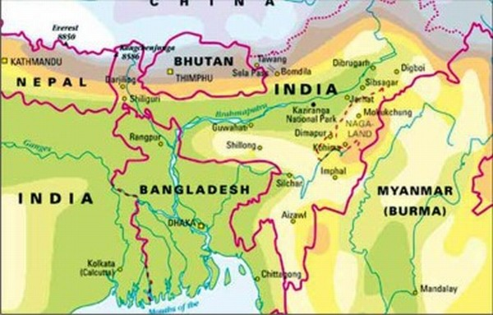
Brahmaputra system
Enters into Assam Plains near Sadiya
After Sadiya it is known as Brahmaputra
Tributaries: Manas, Subansiri, Dhansiri, Dibang, Lohit and Kapilli
Manas
Dihang
Subansiri
Lohit
Dhansiri
Kapilli
Naga hills
Garo
Khasi
Jaintia
Barail range

Slide 32
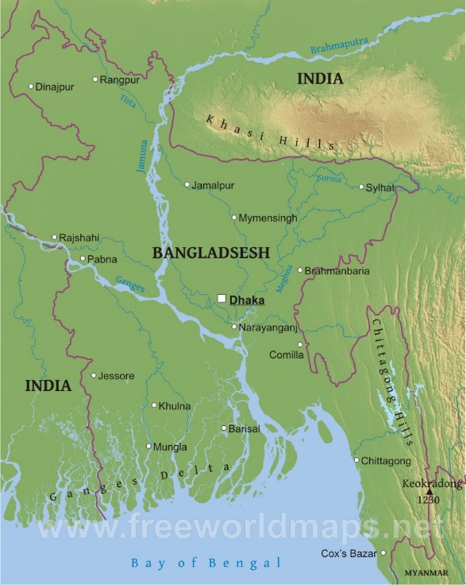
Brahmaputra system
enters Bangladesh as Jamuna
Merged with Ganga – unitedly known as Padma
Meghana river joins
Now known as Meghna
Large delta formation
Brahmaputra
Ganga
Meghna
Padma
Meghna
Delta

Slide 33
UPSC
Question
Q. Consider the following rivers:
Barak
Lohit
Subansiri
Which of the above flows/flow through Arunachal Pradesh?
Prelims
2014

Slide 34
Barak river
Naga Hills
Barak river

Slide 35
UPSC
Question
1 only
2 and 3
1 and 3
1,2 and 3
Ans. B)
Prelims
2014

Slide 36
Northern rivers
Indus
Ganga
Brahmaputra

Slide 37
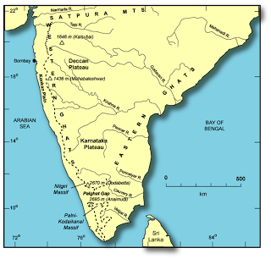
Peninsular rivers
West flowing rivers: Narmada – Tapi
East-flowing rivers: Damodar, Subarnarekha, Mahanadi, Godavari, Krishna, Kaveri etc

Slide 38
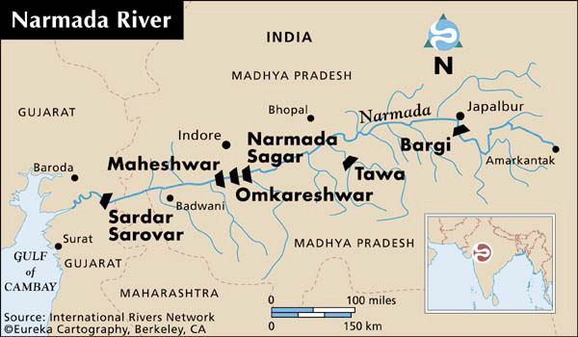
West flowing Peninsular rivers
Narmada:
Source: Amarkantak plateau
Flow in rift valley btwn Vindhyan and Satpura
MP-MH and GJ
Duandhar fall in MP
Merged near Bharuch in GJ
Sardar Sarovar dam

Slide 39
UPSC
Question
Q. Narmada river flows to east to west, while most other large peninsular rivers flow west to east. Why?
It occupies a linear rift valley
It flows between vindhyan and Satpura
The land slope to west from central India
Prelims
2013

Slide 40
UPSC
Question
1 only
2 and 3
1 and 3
None
Ans. A)
Prelims
2013

Slide 41
UPSC
Question
Q. At which one of the following places do two important rivers of India originate; while one of them flows towards north and merge with another important rivers flowing towards Bay of Bengal, the other one flows towards Arabian sea?
Amarkantak plateau
Badrinath
Prelims
2009

Slide 42
UPSC
Question
c) Mahabaleshwar
d) Nasik
Ans. A)
River Son- flows towards north merges with Ganga – towards Bay of Bengal
River Narmada – flows towards Arabian sea
Prelims
2009

Slide 43
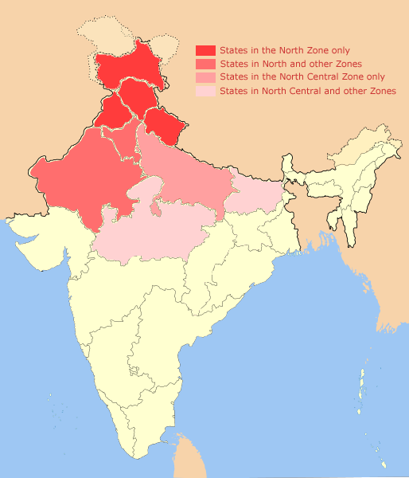
West flowing Peninsular rivers
2) Tapi
Source: Betul plateau
Flow south of Satpura
Imp tributary: Purna river
Merged into sea near Surat
MP-MH-GJ
Rajpipla range
Betul plateau
Tapi river
Gawilgarh range
Purna river

Slide 44
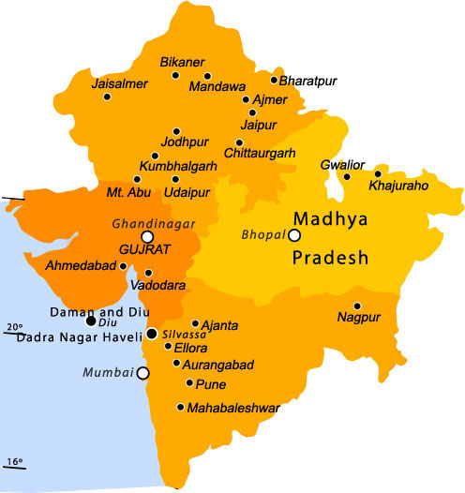
West flowing Peninsular rivers
Others:
Sabarmati from Aravalli range
Mahi from Vindhyans
Aravalli
Mahi
Sabarmati
Vindhyan

Slide 45
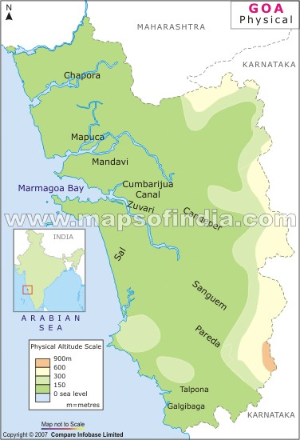
West Flowing Peninsular rivers
West flowing rivers from Western Ghats
Mandovi and Zuari in GOA
Mandovi river
Zuari river

Slide 46
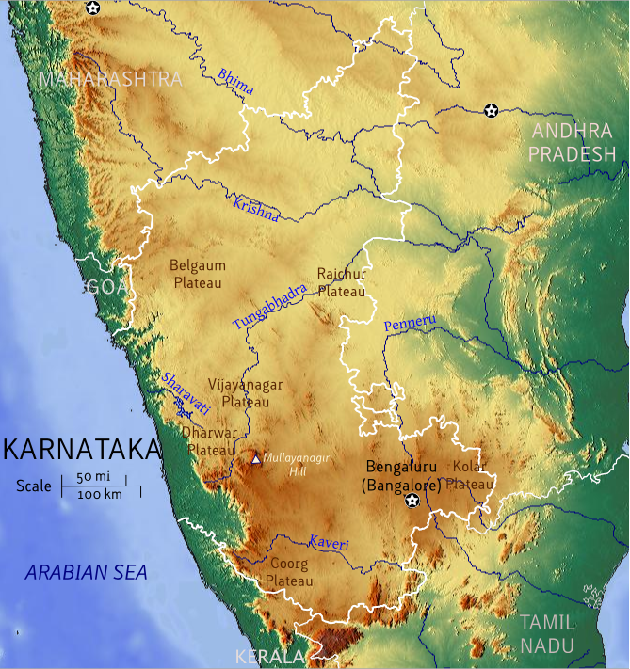
West Flowing Peninsular rivers
Kalinadi, Sharavati in KN
Shravati- Jog fall (highest)
Kalinadi
Sharavati
Netravati

Slide 47
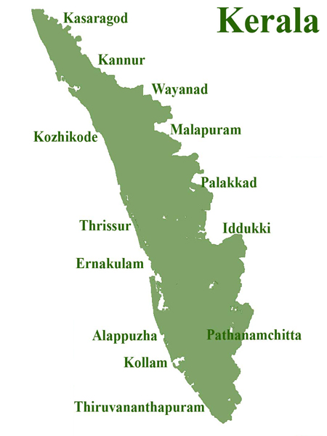
West Flowing Peninsular rivers
Periyar and Pamba in KR
Periyar river
kochi
Annamalai hills
Vembnad lake
Pamba river
Cardamom hills

Slide 48
Northern rivers
Indus
Ganga
Brahmaputra

Slide 49
East Flowing Peninsular rivers
Damodar
Source: chhota Nagpur plateau
Tributary: Barakar
Iron and steel industry
Barakar river
Damodar river
Chhota Nagpur plt

Slide 50
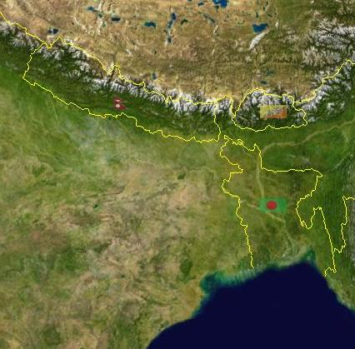
East Flowing Peninsular rivers
2) Subarnarekha, Baitrani and Brahmani
Subarnrekha – from Ranchi plateau
Baitrani- Garhjat hills
Brahmani – headward streams, South Koel and Sankh from Chhota Nagpur plateau
Ranchi plateau
Subarnrekha
Garhjat hills
Brahmani
Baitrani

Slide 51
East Flowing Peninsular rivers
3) Mahanadi
Source: Danadkarnya
Left bank: Sheonath, Hasdo and Mand
Right bank: Tel, Jonk, Ong
Hirakund dam
Hasdo
Mand
Sheonath
Mahanadi
Ong
Tel

Slide 52
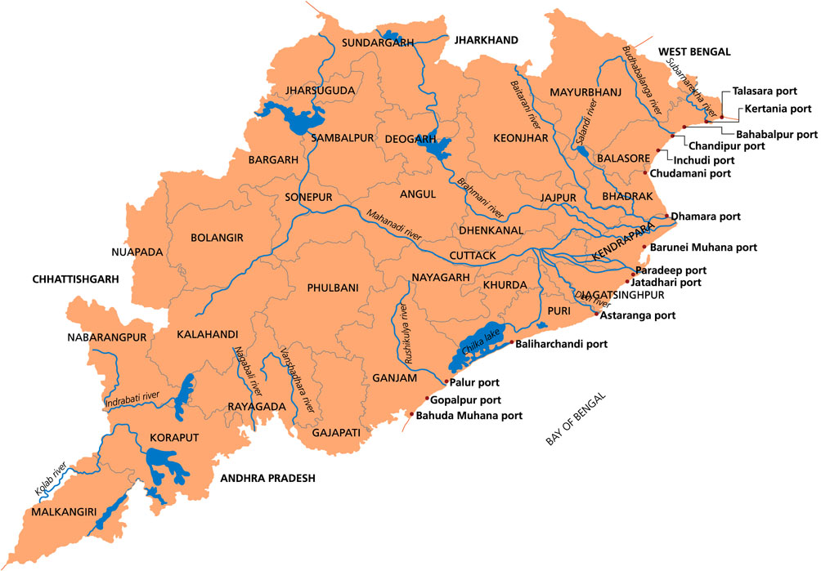
East Flowing Peninsular rivers
4) Rushikulya
Source: Nayagarh hills
Mouth known for: hatching site of Olive ridley turtles
Chilka lake
Rushikulya river

Slide 53
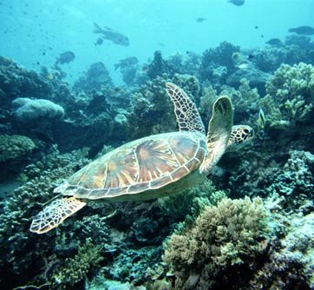
Oilve Ridley turtles
The smallest and most abundant of all sea turtles found in the world
They live in warm waters of the Pacific, Atlantic and Indian oceans.
Olive ridley turtles IUCN status- “endangered”

Slide 54
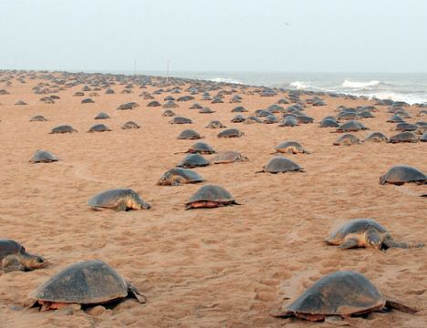
Olive Ridley turtles on Odisha coast
known for their unique mass nesting called “Arribada”= thousands of females come together on the same beach to lay eggs.
Orissa coast is the largest mass hatching site of Olive ridley turtle in the world.

Slide 55
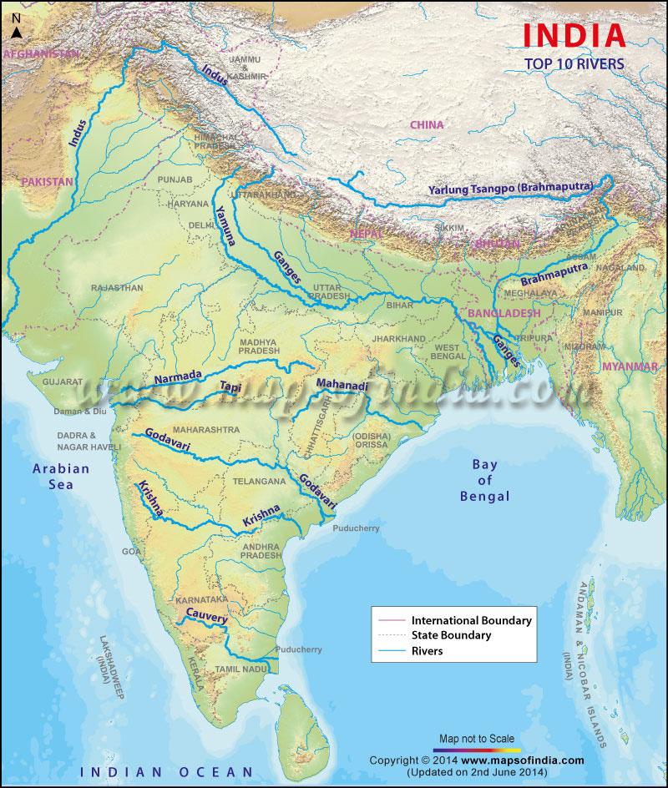
East Flowing Peninsular rivers
5) Godavari:
Source: Trimbak plt
Left bank tri:
Penganga, Wardha, Wainganga (combined = Pranhita), Indravati (fall), Sabari and sileru
Right bank tri:
Manjara
Wenganga
Penganga
Wardha
Indravati
Balaghat
Pranhita
Sabari
Manjara
Sileru

Slide 56
East Flowing Peninsular rivers
6) Krishna:
Source: Mahabaleshwar
Left bank tri:
Musi, Sina,Bhima, Ghat prabha, Malprabha, Tungbhadra, Hagari
Sina
Bhima
Musi
Ghatprabha
Malprabha
Hagari
Tungbhadra

Slide 57
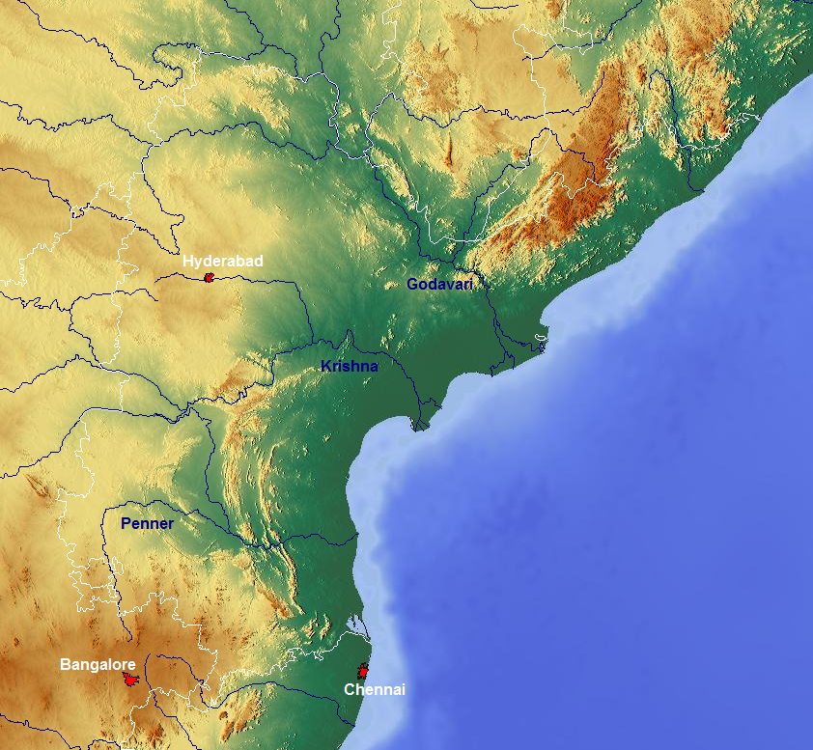
East Flowing Peninsular rivers
7) Penneru/Penner:
Source: Nandi durg peak in KN
Tri: Kunder, Charavati, Papagni, Punchu

Slide 58
East Flowing Peninsular rivers
8) Kaveri:
Source: Tal kaveri at Brahmagiri hills
Left bank tri:
Shimsa, Hemvati, Kabani, Bhavani, Noyil, Amaravati
hemvati
Shimsa
Kabani
Bhavani
Noyil
Amravati

Slide 59
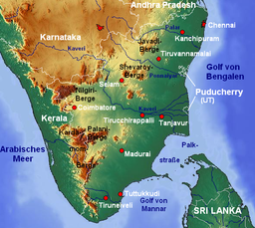
East Flowing Peninsular rivers
9) Vaigai:
Source: Varushand Hills
Madurai located on Vaigai river
Dry channel
Disappear then again re-appear
Varushand Hills

Slide 60
UPSC
Question
Q. The correct sequence of eastward flowing rivers of Peninsular India from north to south is:
Subarnarekha- Mahanadi- Godavari- Krishna-Pennar- Cauveri- Vaigai
Subarnarekha – Mahanadi- Krishna –Cauveri- Pennar- vaigai
Prelims
2002

Slide 61
UPSC
Question
c) Mahadnadi- Subarnarekha- Godavari- Krishna- Cauveri- Pennar- Vaigai
d) Mahanadi- Subarnarekha- Krishna- Godavari- Cauveri- Vaigai-Pennar
Ans. A)
Prelims
2002

Slide 62
UPSC
Question
west-flowing rivers of Peninsular India have no deltas
(R) These rivers do not carry any alluvial sediments
Both correct and R is correct explanation of A
Both correct but R is not correct explanation of A
Prelims
2004

Slide 63
UPSC
Question
c) A is true R is false
d) A is false R is true
Ans. A)
West flowing river- short distance – no alluvial – no delta
Prelims
2004

Slide 64
River linking project
First time recommended by Sir Arthur Cotton in 19th cent
Aims to transfer surplus water of some rivers to water deficit river basins
K.L. Rao, MoWR: Ganga-Kaveri link
Dishaw Dastur, pilot: transferring of water using garland canal

Slide 65
River linking project
Transfer of water of Ganga and Brahmaputra towards west and east in south using 14 canals
In peninsula plateau: linking of rivers using 16 canals

Slide 66
River linking project
Largest inter-basin transfer of water in the world if executed
Project will take 50-100 years to complete
May produce 35GW of power

Slide 67
River linking project
Favour:
Management of flood and drought
Expansion of irrigation network
Drinking water supply

Slide 68
River linking project
Challenges:
Indian monsoon climate: rainy months and dry months occur at the same in the entire country
Dams and canals- not proper solution to floods
Plateau higher (upland) than northern plains – difficult to pumping of water from plains to peninsula

Slide 69
River linking project
4) That require large amount of energy and canals
5) Submergence of forests and villages
6) Blocking of rivers – damage to riverine ecosystem
7) International water disputes and inter-state water disputes

